Slide 1


Multi-omics Boot Camp
Analysis of Omics Data for Research Studies
Advanced Clustering
Kimberly Siegmund
Instructor, USC
Qiran Jia
Workshop Guide, USC

Slide 2
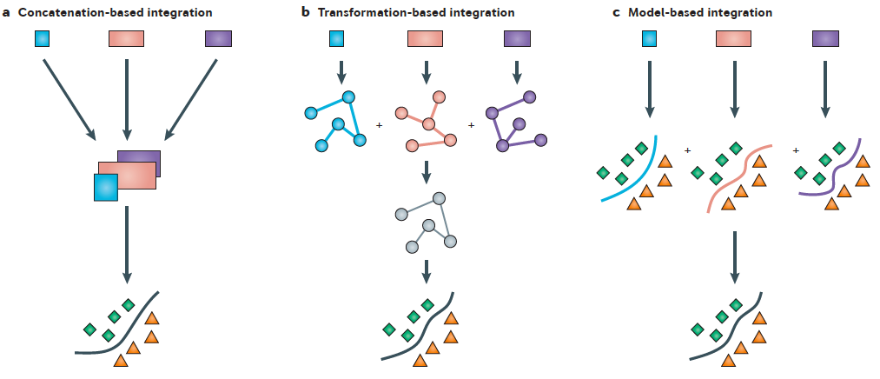
Approaches for Integrating Data
Ritchie et al. (2015) Nat Rev Genet
Concatenation-based Transformation-based Model-based
Blue, orange, purple boxes denote different data types
Notes:
They describe three different approaches for integrating the data, concatenation-based, transformation-based and model-based.
For each of these models the Blue, orange and purple boxes denote different data types.
For Concatenation-based, they just concatenate all variables from the different platforms to predict phenotype. All features are treated similarly, and the problem is very high-dimensional.
In the transformation-based approach, might use perform dimension reduction for individual data types before combining across data types. E.g., MCIA
Model-based builds models from single data types before building a model from models.

Slide 3
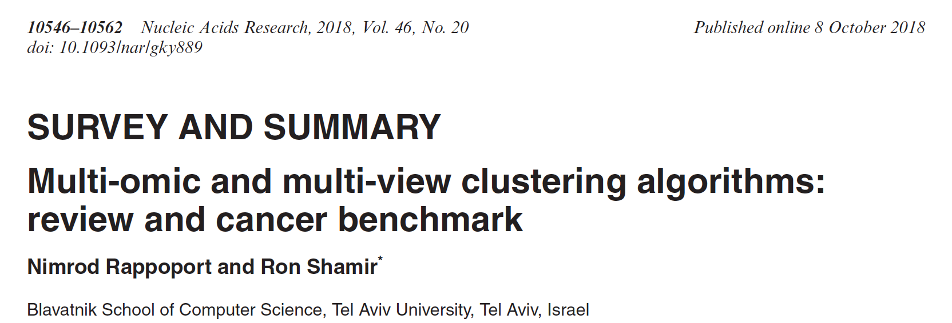
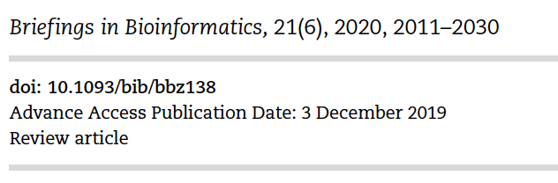
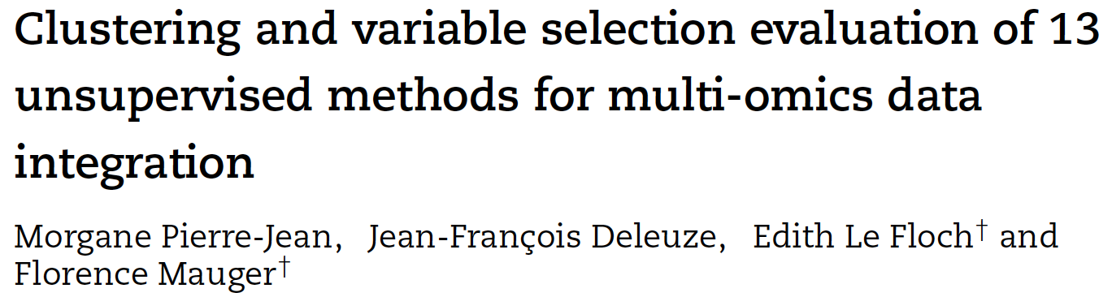
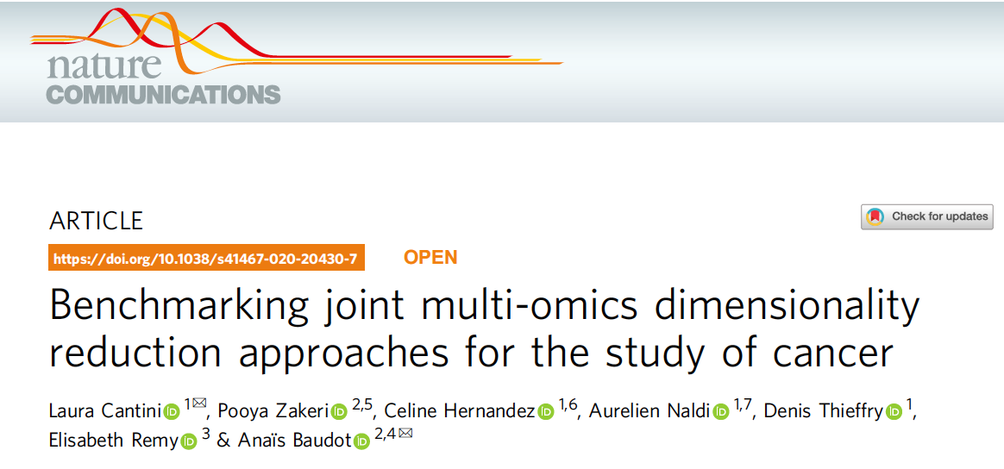


Slide 4
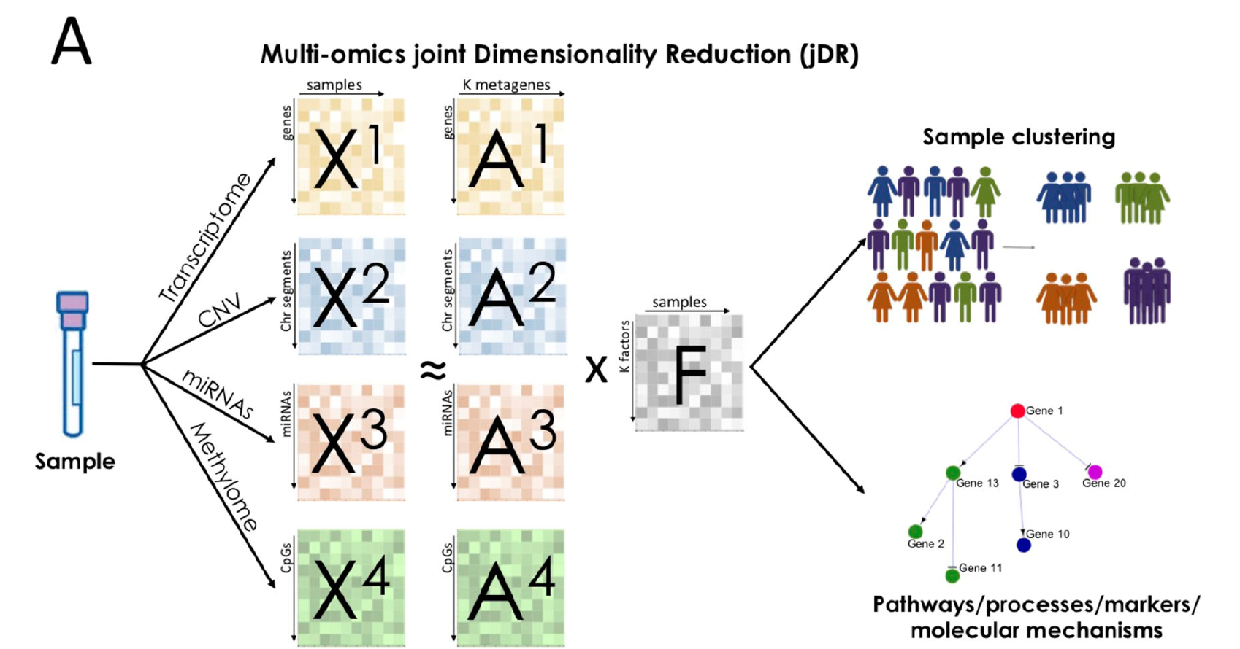
Notes:
Benefit of these approaches compared to some others is that
1. we do not need to match the features from the different omics platforms.
There is an extension of k-means to multiple omics, but the feature filtering is directed by gene annotation in addition to variation.
2. They are FAST. Some of the joint approaches are elegant in their model, but slow to fit.

Slide 5
jDR
Transformation-based
1. Consensus PCA CPCA
2. Regularized generalized CCA RGCCA
3. Multiple co-Inertia analysis MCIA
vs. Early Integration: PCA on concatenated data
Notes:
moCluster paper:
In addition to the centering and scaling of features in each
data set, the integrative analysis of multiple data sets requires a
normalization on data set level because the one with more
features (columns) often has more overall variance. In this
study, we solved this issue by weighting each data matrix by the
reverse of its first eigenvalue, allowing different matrices to
contribute comparable variance to the first (few) JLV(s). After

Slide 6
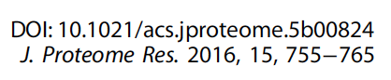
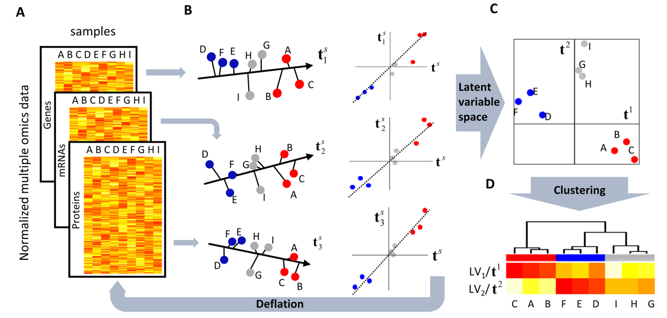
Consensus PCA
Notes:
moCluster paper:
Center and scale each data set. Downweight blocks with more features/variables, otherwise the larger blocks will have higher influence on the solution.
Initialize joint latent variable t1. Then find Find Block latent variable (BLV1) that has maximum correlation to the
In addition to the centering and scaling of features in each
data set, the integrative analysis of multiple data sets requires a
normalization on data set level because the one with more
features (columns) often has more overall variance. In this
study, we solved this issue by weighting each data matrix by the
reverse of its first eigenvalue, allowing different matrices to
contribute comparable variance to the first (few) JLV(s).

Slide 7
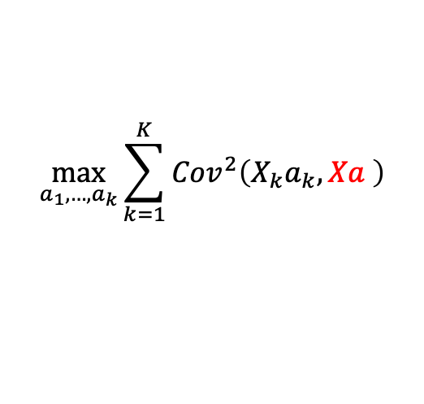
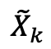
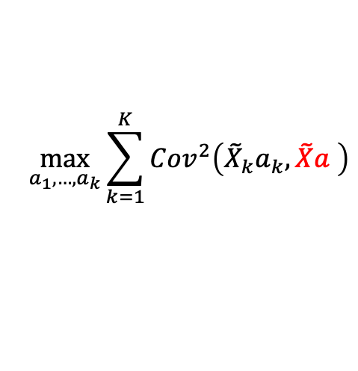
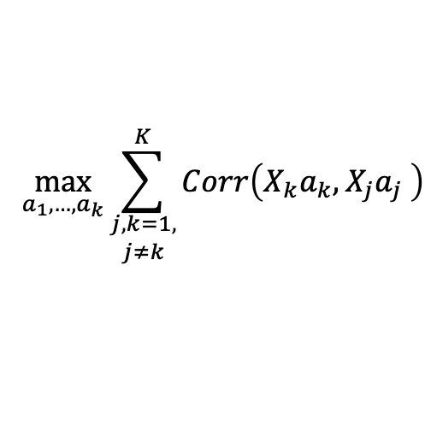
$$\max_{a_{1},…,a_{k}}{\sum_{k=1}^{K}{{Cov}^{2}\left(X_{k}a_{k},Xa \right)}}$$
CPCA
BLV
JLV
Same goal as JIVE
$$\max_{a_{1},…,a_{k}}{\sum_{\begin{aligned}j,k=1, \\ j≠k\end{aligned}}^{K}{Corr\left(X_{k}a_{k},X_{j}a_{j} \right)}}$$
RGCCA
Available in R package ‘mogsa’
$$\max_{a_{1},…,a_{k}}{\sum_{k=1}^{K}{{Cov}^{2}\left({\tilde{X}}_{k}a_{k}, \tilde{X}a \right)}}$$
MCIA
Starts with from PC of
individual omic analysis
$${\tilde{X}}_{k}$$
Notes:
Briefings in Bioinformatics, 21(6), 2020, 2011–2030
MCIA is a special case of RGCCA

Slide 8
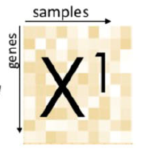
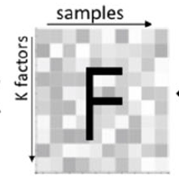
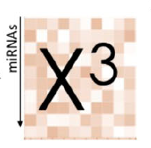
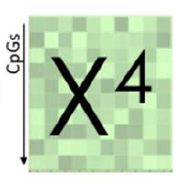
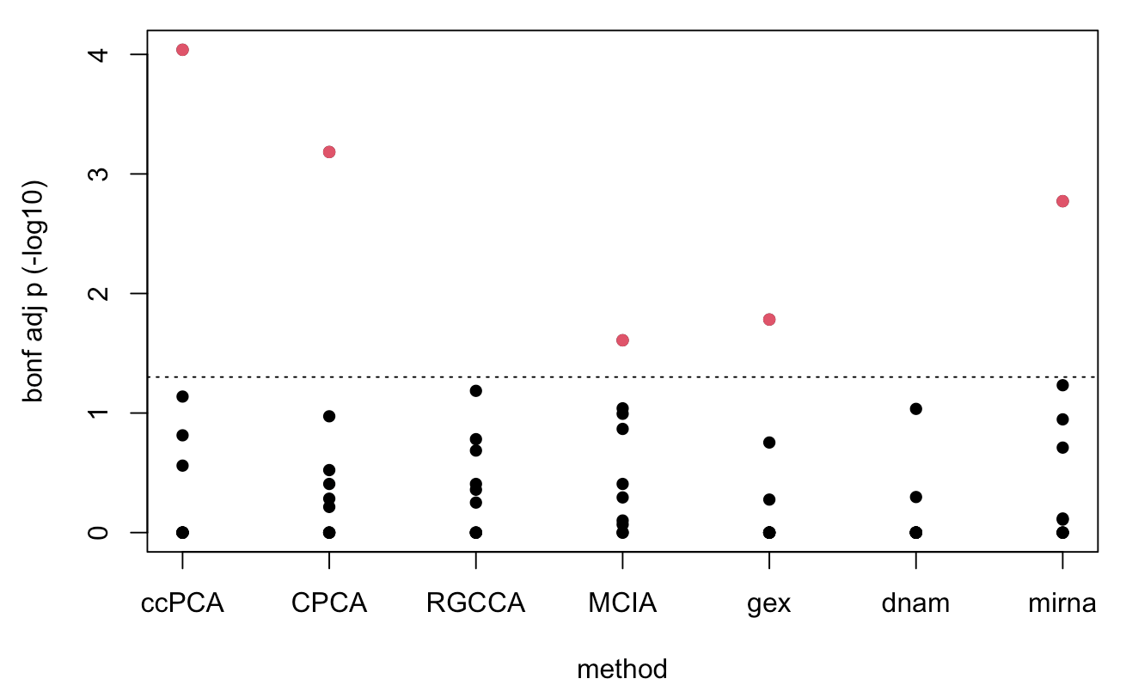
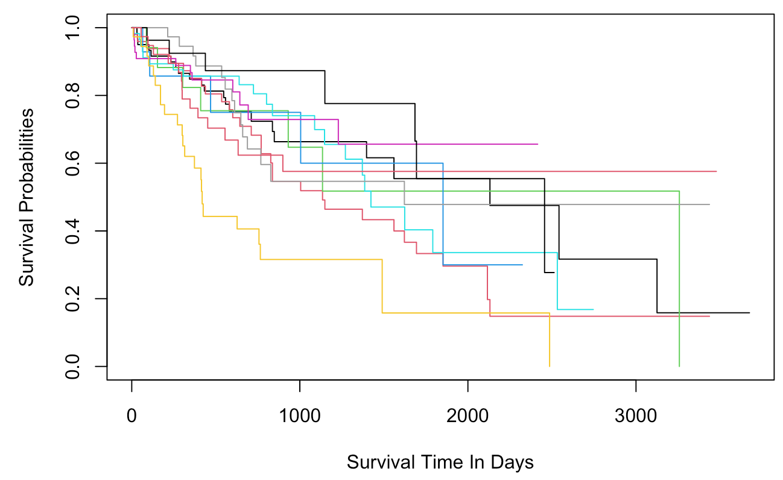
http://acgt.cs.tau.ac.il/multi_omic_benchmark/download.html
Analysis:
Estimate 10 common latent variables
Apply K-means clustering to LVs
3. Validate with patient survival time

Slide 9
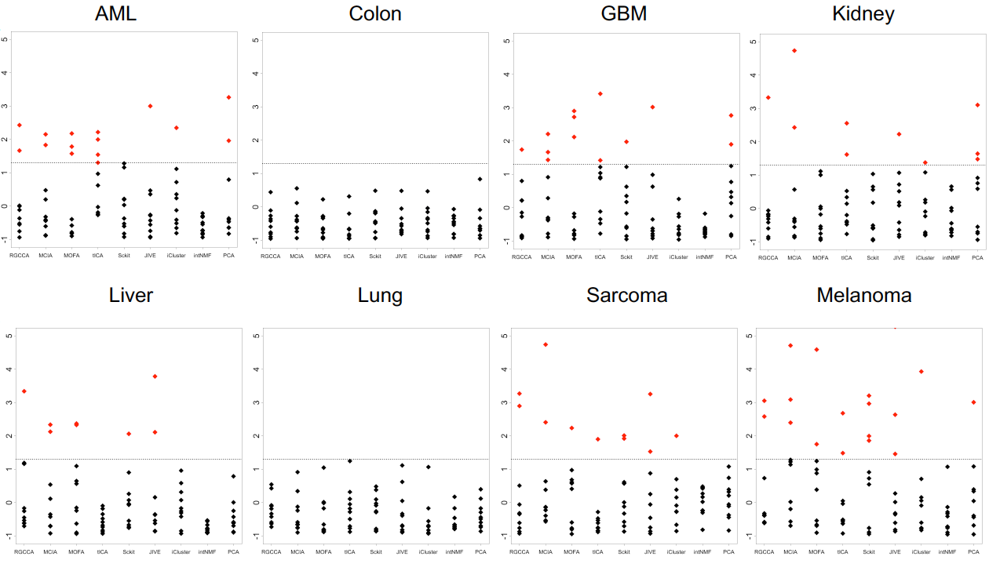
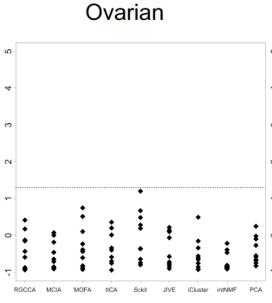
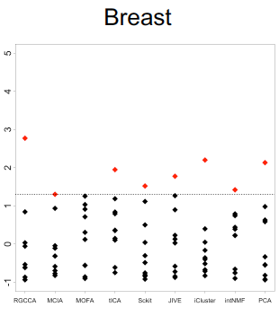
RGCCA
MCIA
JIVE
PCA gex

Slide 10

Summary
There is no single best analysis for all datasets
Explore different methods
Validate and interpret your results

Slide 11
Lab
Clustering LIHC
PCA concatenated data
CPCA
(R)GCCA
MCIA
PCA Gene Expression
PCA DNA methylation
PCA miRNA
Compare jDR vs DR
Things to explore: The effect of variable selection
Try top 1000 variable genes, 1500 CpGs, 470 (all) miRNAs

